Slide 1
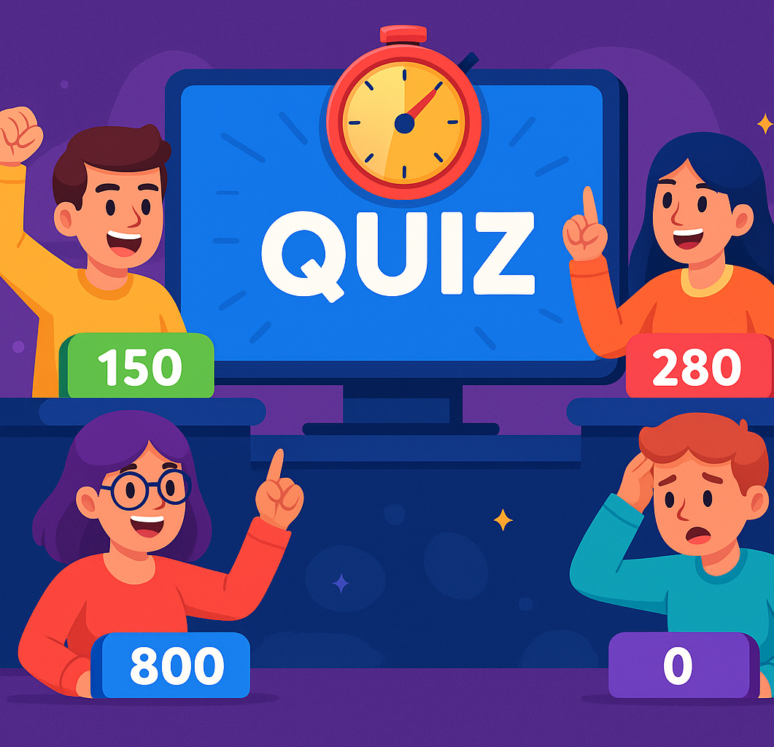
MIND CLASH Battle of Wits
Team members:
Pranay,
Prudhvi,
Himavanth
Course: CS-161
Instructor: Dominic Abucejo

Slide 2
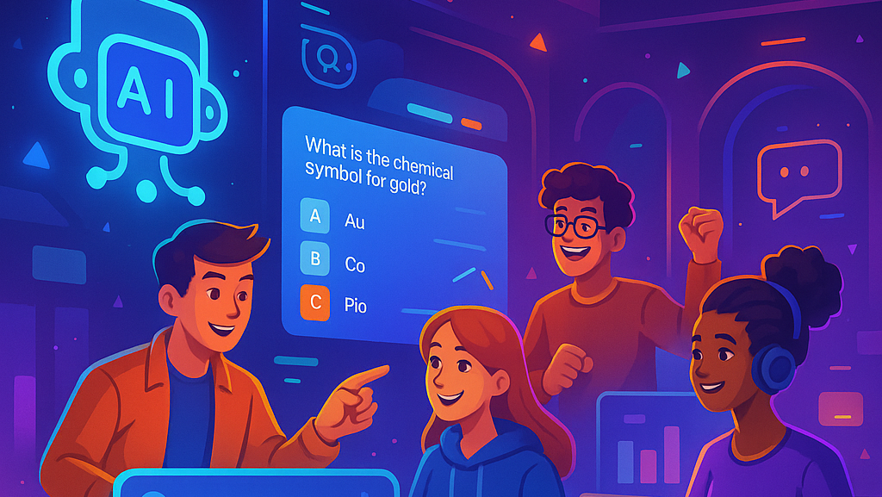
Our Vision
To become the go-to platform for gamified learning by merging real-time multiplayer quizzes, AI-driven content, and interactive 3D experiences that make education feel like play.

Slide 3
Project Overview
Real-time multiplayer quiz competition platform
AI-powered quiz generation capabilities
Customizable 3D avatars and interactive UI
Built with modern web technologies
Targeted at trivia enthusiasts and casual gamers

Slide 4

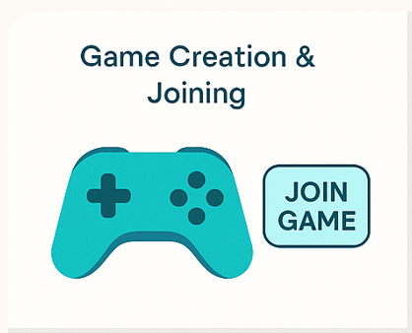
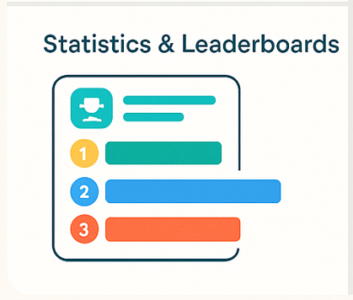
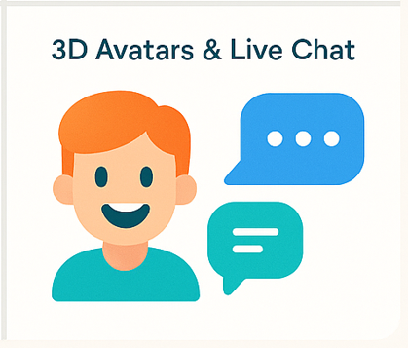
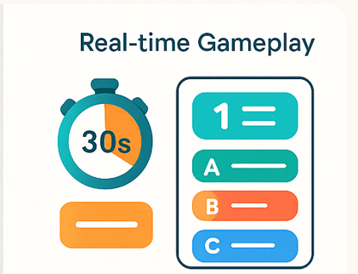
Key Features

Slide 5
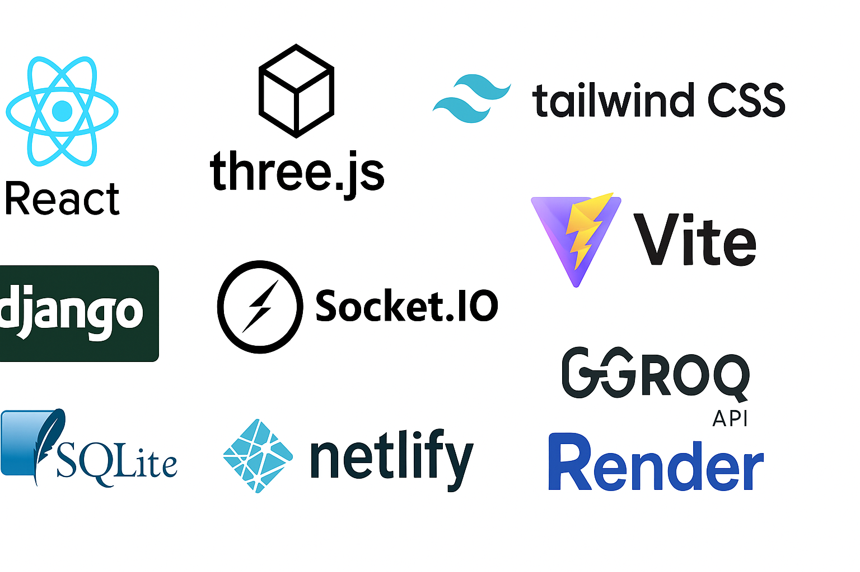
TECHNOLOGY STACK

Slide 6
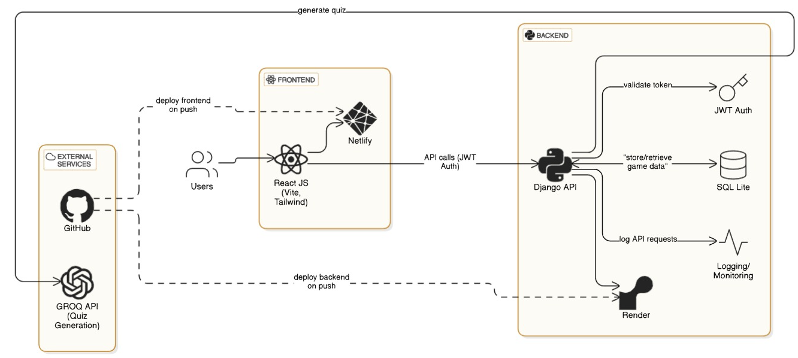
ARCHITECTURE DIAGRAM

Slide 7
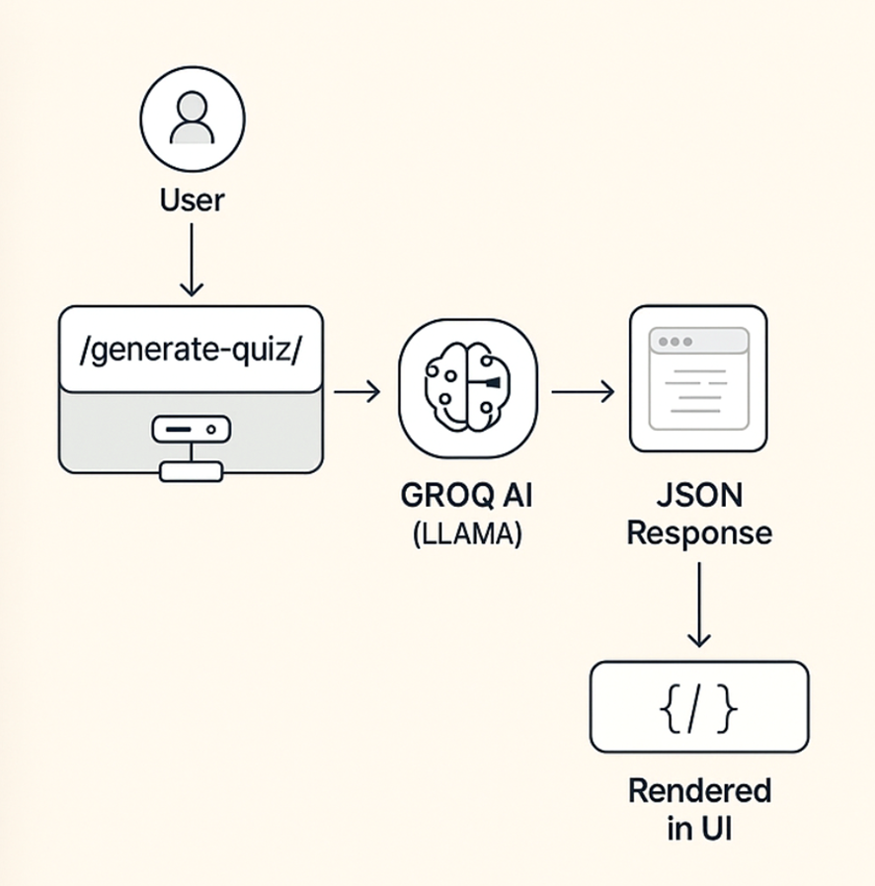
AI QUIZ INTEGRATION
🧠 AI-powered quiz creation using GROQ API (LLAMA model)
🔄 Quizzes are dynamically generated based on selected topics and difficulty
📄 GROQ responds with structured JSON containing questions, options, and correct answers
🧩 Frontend parses JSON and renders quiz UI in real time
⚙️ Ensures non-repetitive, diverse questions for every game session

Slide 8
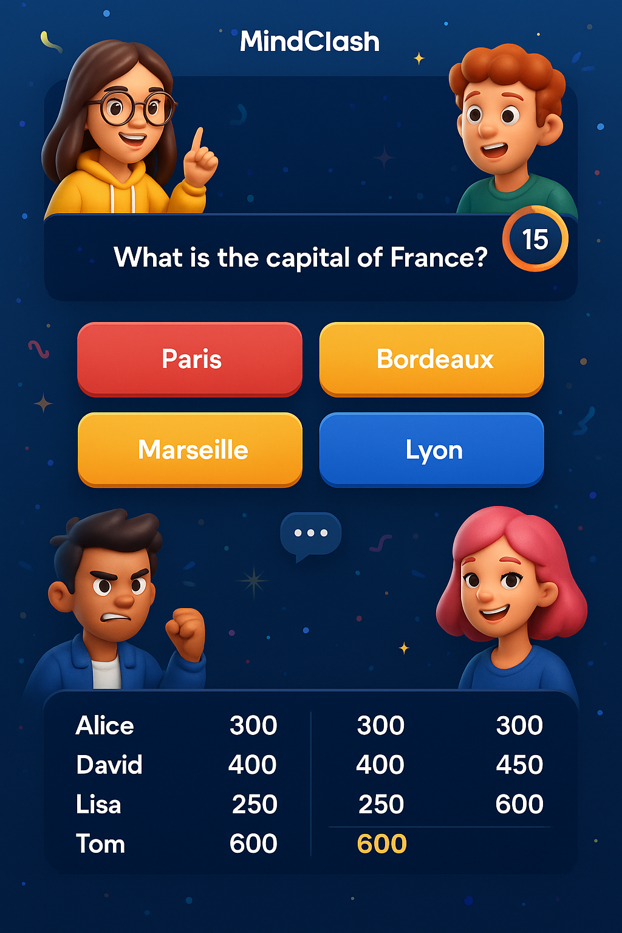
REAL TIME GAMEPLAY
30-second timer/question
Leaderboard after each question
Avatars reflect player actions
Chat support during quiz

Slide 9
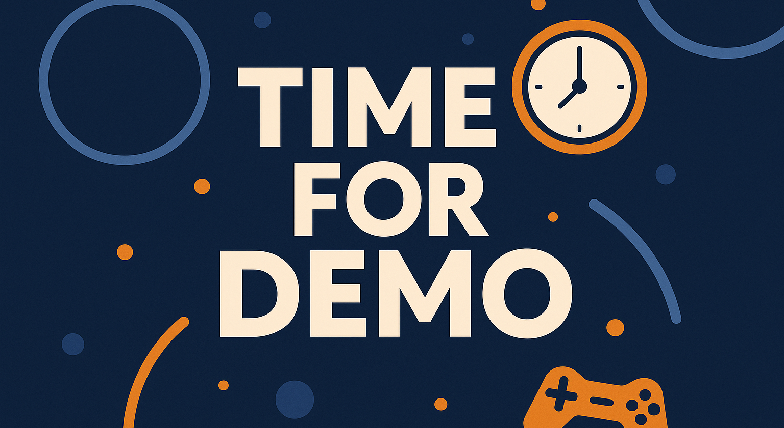

Slide 10
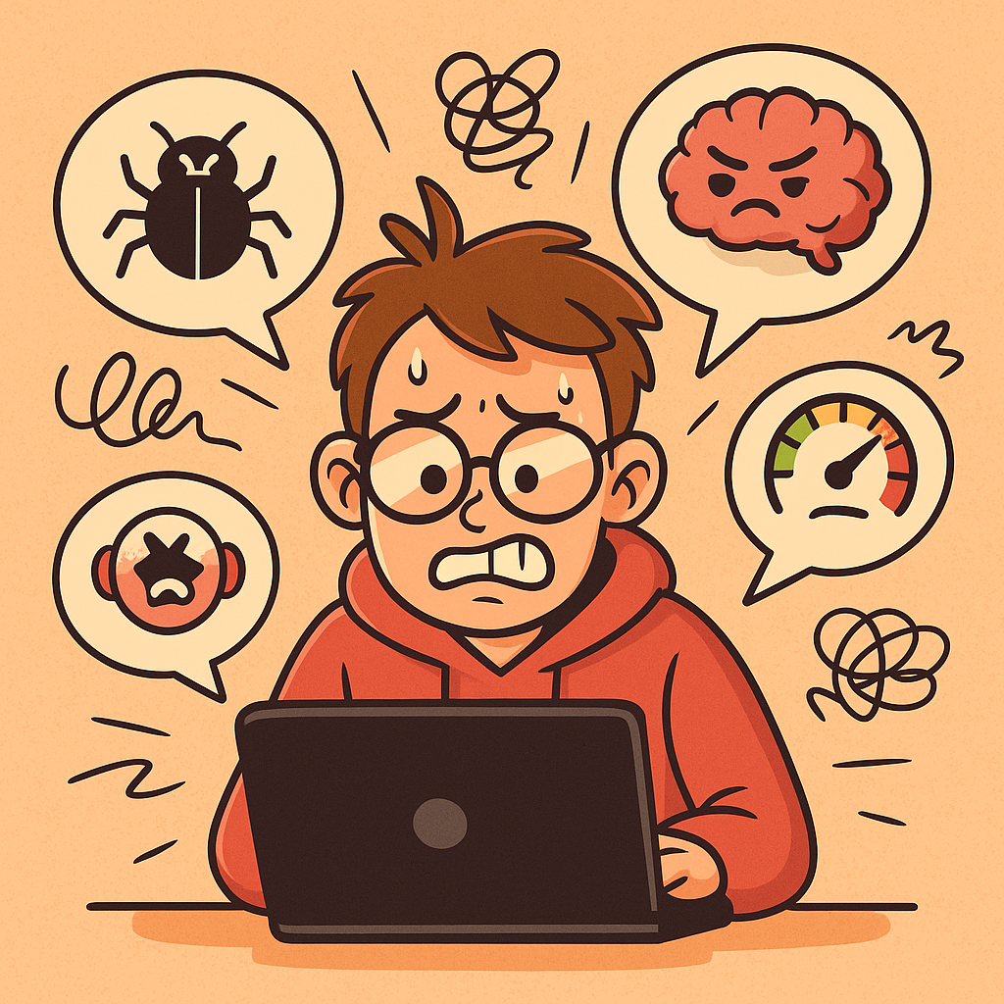
Technical Challenges Faced
Real-time synchronization across players
GROQ AI Integration.
3D Avatar Creation and Integration
Power Ups – 50:50 and Hint Attempts Not Successful

Slide 11
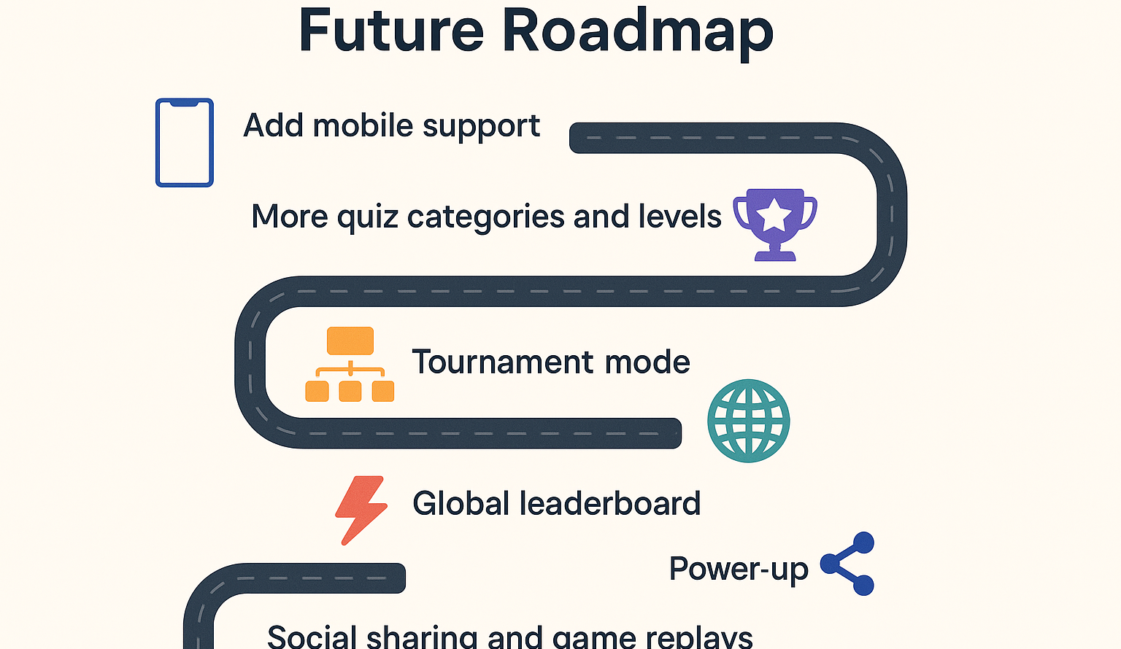

Slide 12
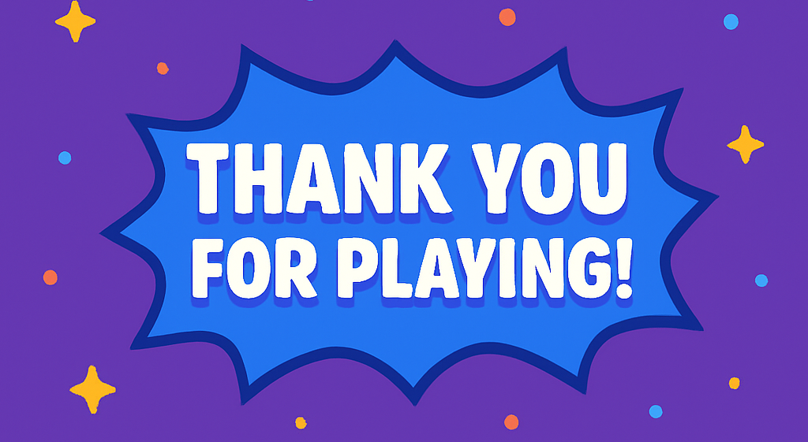

Slide 13


